Slide 1
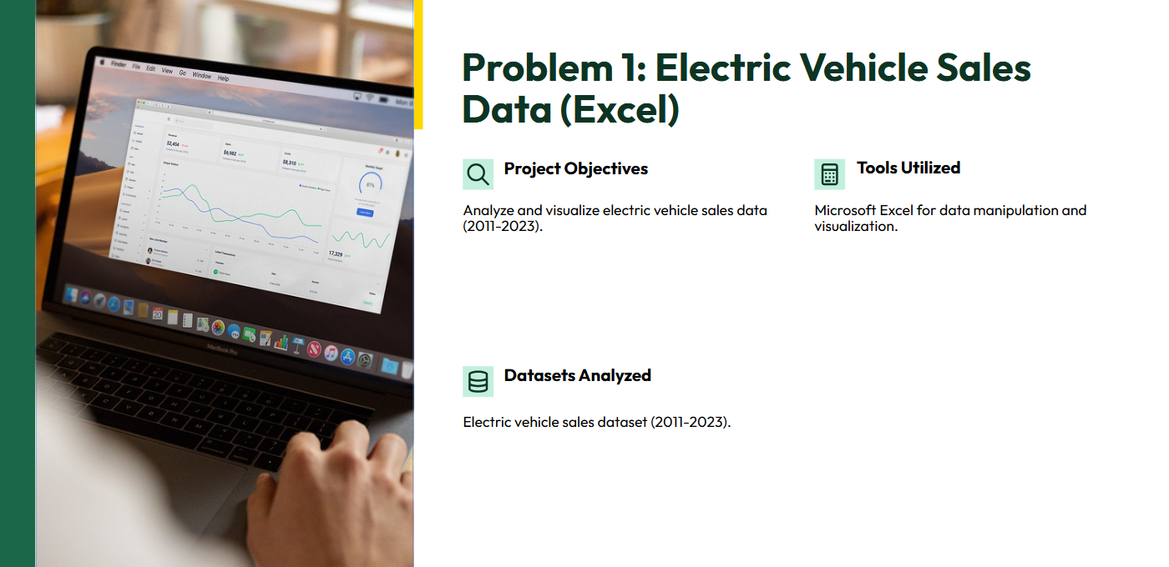

Slide 2
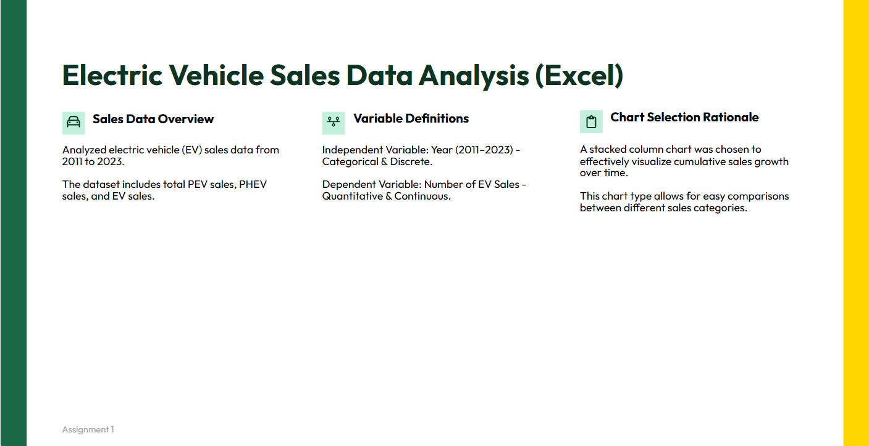

Slide 3
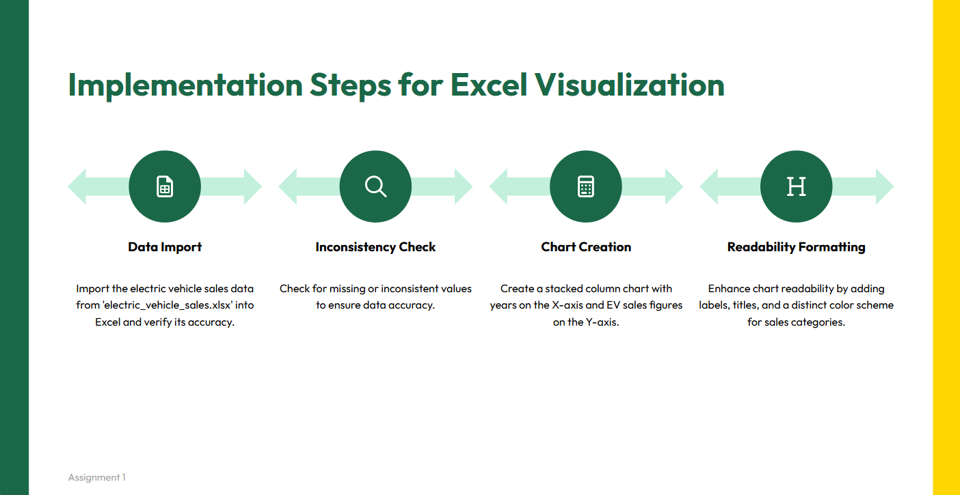

Slide 4

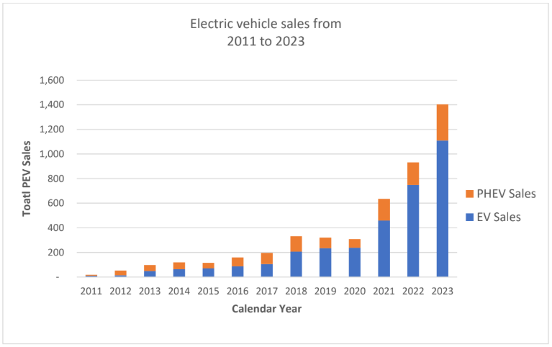
Output:

Slide 5
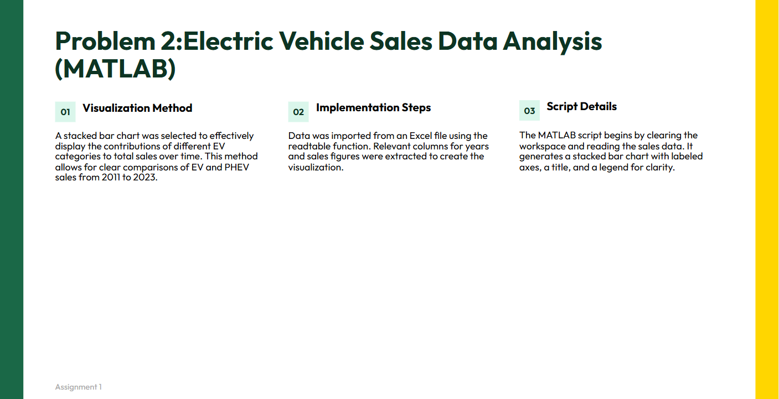

Slide 6
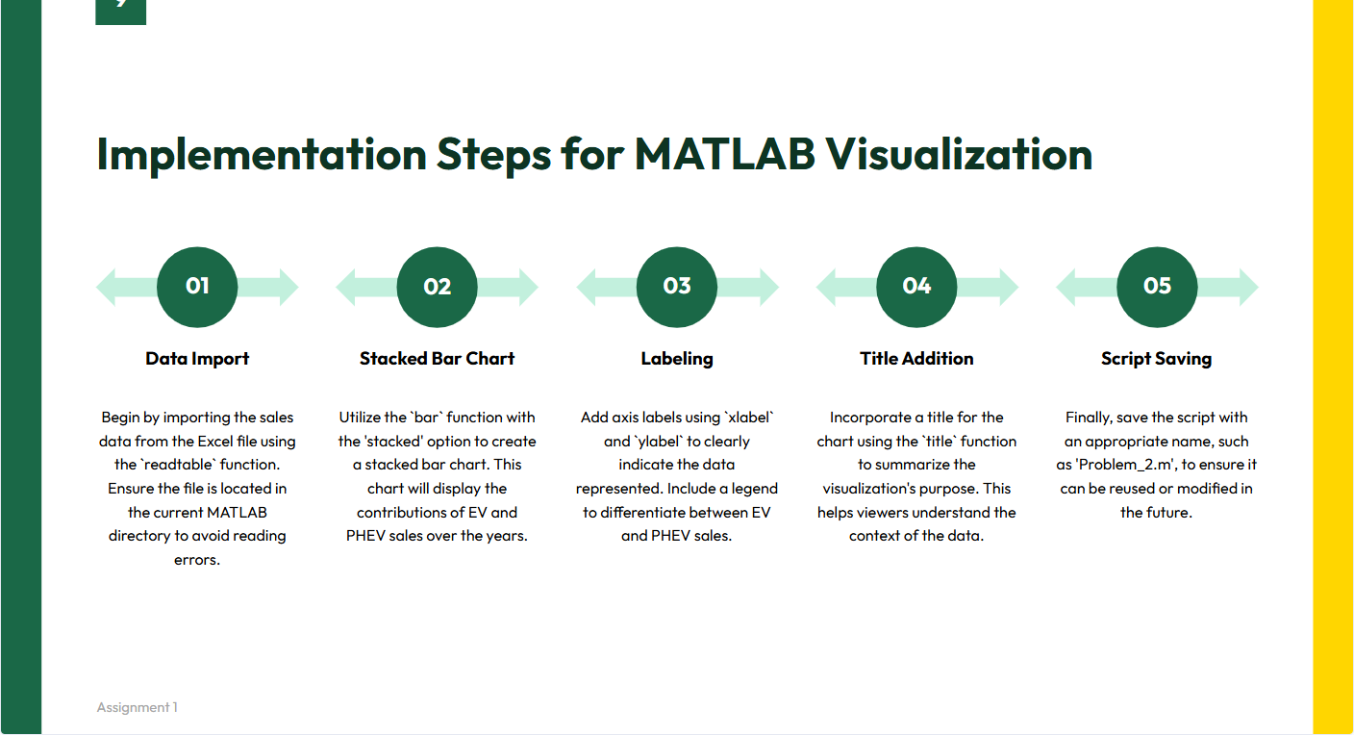

Slide 7

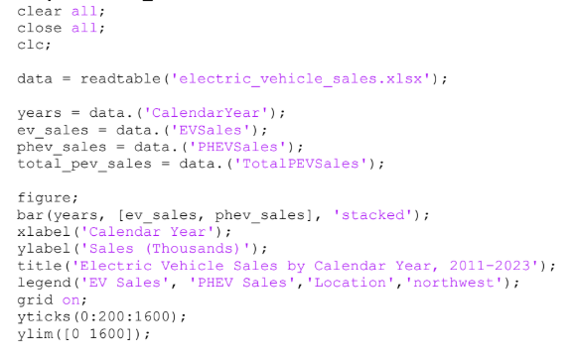
Code

Slide 8
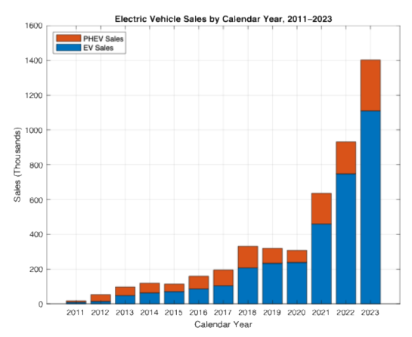
Output

Slide 9
Problem 3: Analysis
Understanding the Data
Categories (Independent Variable - Discrete)
Grand Slams
ATP Finals
ATP Masters 1000
Total Titles
Number of Titles (Dependent Variable - Continuous):
Titles won by Carlos Alcaraz
Titles won by Jannik Sinner
Choosing the Right Chart Type
Since we were comparing two players across multiple categories, a grouped horizontal barchart was the most effective visualization.
• Reasons for choosing a horizontal bar chart
Better readability when comparing values across multiple categories.
Bars of different lengths make it easy to distinguish differences.
Avoids overlapping which could happen in vertical bar charts with many categories.

Slide 10
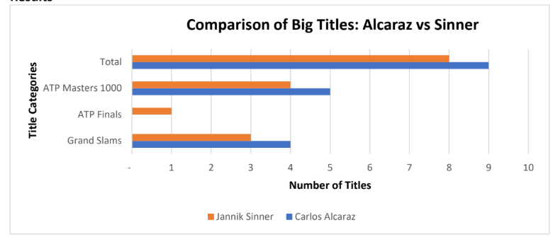
Implementation Steps (Excel)
1. Entered the provided achievement data in an Excel table.
2. Inserted a grouped bar chart to compare their performance.
3. Customized the chart with appropriate colours, labels, and titles.
4. Saved the Excel file “comparison_of_Big_Titles.xlsx.
Output

Slide 11
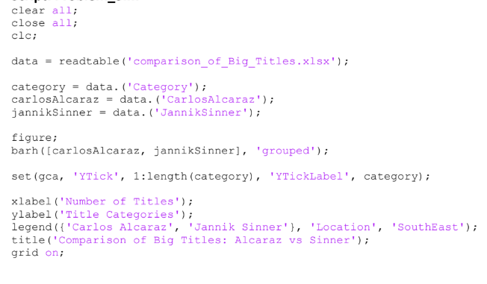
Implementation Steps (Matlab)
1. Created a table in MATLAB with the achievement data.
2. Used the bar function to generate a grouped bar chart.
3. Customized the chart with labels, legends, and colours.
4. Saved the “Problem_3.m” script.
Code

Slide 12
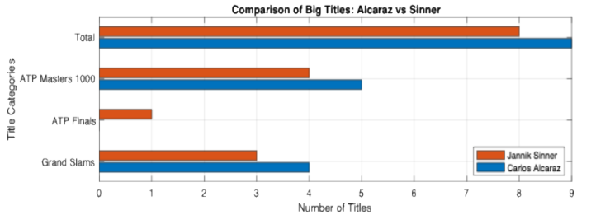
Output

Slide 13


